Slide 1
Pay to Go Shower System
K.O.D Inc
Nicoy Smith
Kenneth Anglin
Ottor Mills
David Thomas

Slide 2
Introduction

Slide 3
Introduction to Software Modelling
Software Modelling is the abstraction of a Software Application before coding.
A better understanding of any system can be obtained by considering it from different perspectives such as Requirements Models, Static Models, and Dynamic Models of the Software System.

Slide 4
Introduction to Pay to Go Shower System
The idea of Pay to Go Shower System was first conceptualized after the realization that it is really difficult to use a public bathroom in comfort.
It allows individuals to be cleansed quickly and thoroughly through the payment of a small fee.
It allocates the optimal amount of soap and water based on the showerers dimensions.

Slide 5
Requirements Analysis

Slide 6
What is Requirements Analysis ?
Requirements analysis, also called requirements engineering, is the process of determining user expectations for a new product.

Slide 7
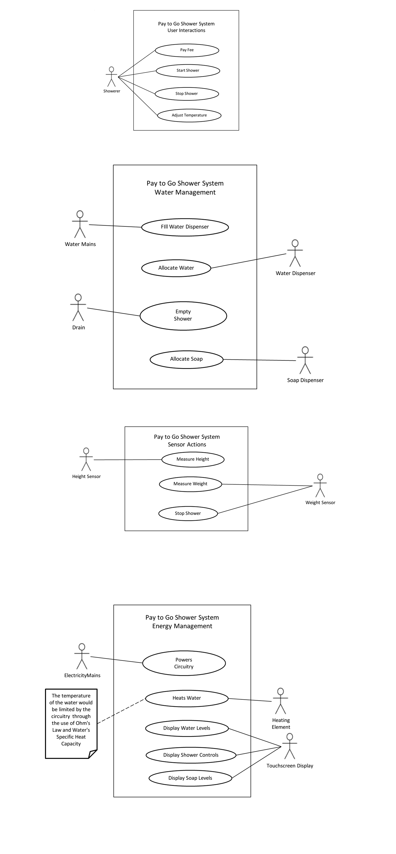
Requirements Analysis
Use Case Diagrams

Slide 8
Requirements Analysis
Use Case Diagrams

Slide 9
Requirements Analysis
Use Case Diagrams

Slide 10
Requirements Analysis
Use Case Diagrams

Slide 11
Requirements Analysis
Use Case Textual Descriptions
Use case name: Pay Fee
Summary: The shower transaction is paid for
Actor: Showerer
Precondition: User has enough money
Main Flow:
1. User uses smartphone to scan QR Code
2. User completes payment process

Slide 12
Requirements Analysis
Use Case Textual Descriptions
Use case name: Start Shower
Summary: The User starts the Shower Process
Actor: Showerer
Precondition: User has paid their showering fee
Mian Flow:
1.User steps into the shower.
2.The weight sensor is activated
3.The users weight is the determined
4.The users weight data is sent to the system

Slide 13
Requirements Analysis
Use Case Textual Descriptions
Use case name: Stop Shower
Summary: The User stops the Shower Process
Actor: Showerer
Precondition: The User has started the shower
Mian Flow:
1. User starts the shower process
2. User stops the shower process

Slide 14
Requirements Analysis
Use Case Textual Descriptions
Use case name: Adjust Temperature
Summary: The user changes the temperature of the water.
Actor: Showerer
Precondition: Fee has been paid.
Mian Flow:
1. User pays fee
2. User enters Shower
3. User sets desired temperature of water

Slide 15
Static Modelling

Slide 16
What is Static Modelling ?
Static Modelling represents a system in the form where it does change or vary with time. In other words it defines the classes of a system, the relationship between these classes and the functionalities of each class.

Slide 17
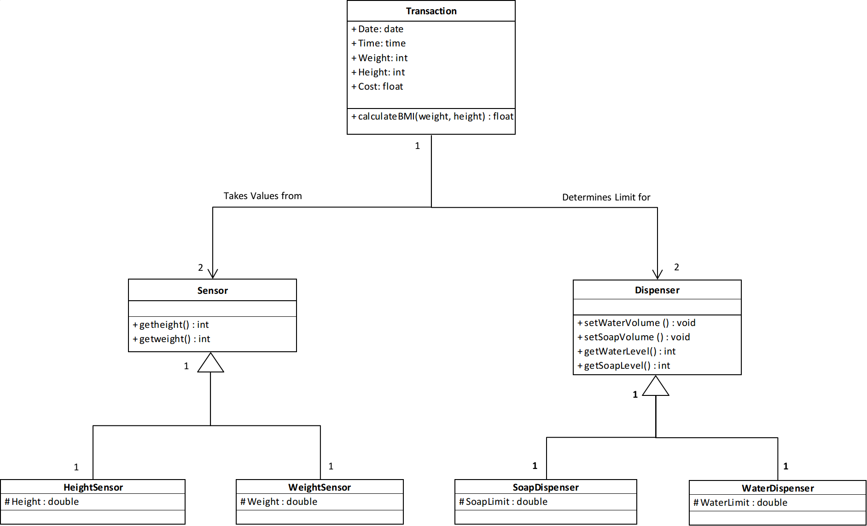
Static Modelling
Class Diagram

Slide 18
Static Modelling
Class Diagram Textual Description
The class diagram shows an overview of the system. A transaction consists of a flat fee however the allocated soap and water to a user determined by the values returned by the height and weight sensors. By default an optimal amount for the average person is allocated to the dispensers upon payment as this prevents unnecessary wastage, however if the client’s weight is too high or body mass index (BMI) calculated from the values returned by the height and weight sensors is above normal levels (overweight or obese) then more soap and water will be allocated to the dispensers to cover the larger surface area of the client. What is not used by the current client remains in the dispenser for the next client which promotes the reservation of resources.

Slide 19
Dynamic Modelling

Slide 20
What is Dynamic Modelling ?
Dynamic Modelling Represents a System at runtime through the instantiation of each class and their interactions that conform to the use cases of the system.

Slide 21
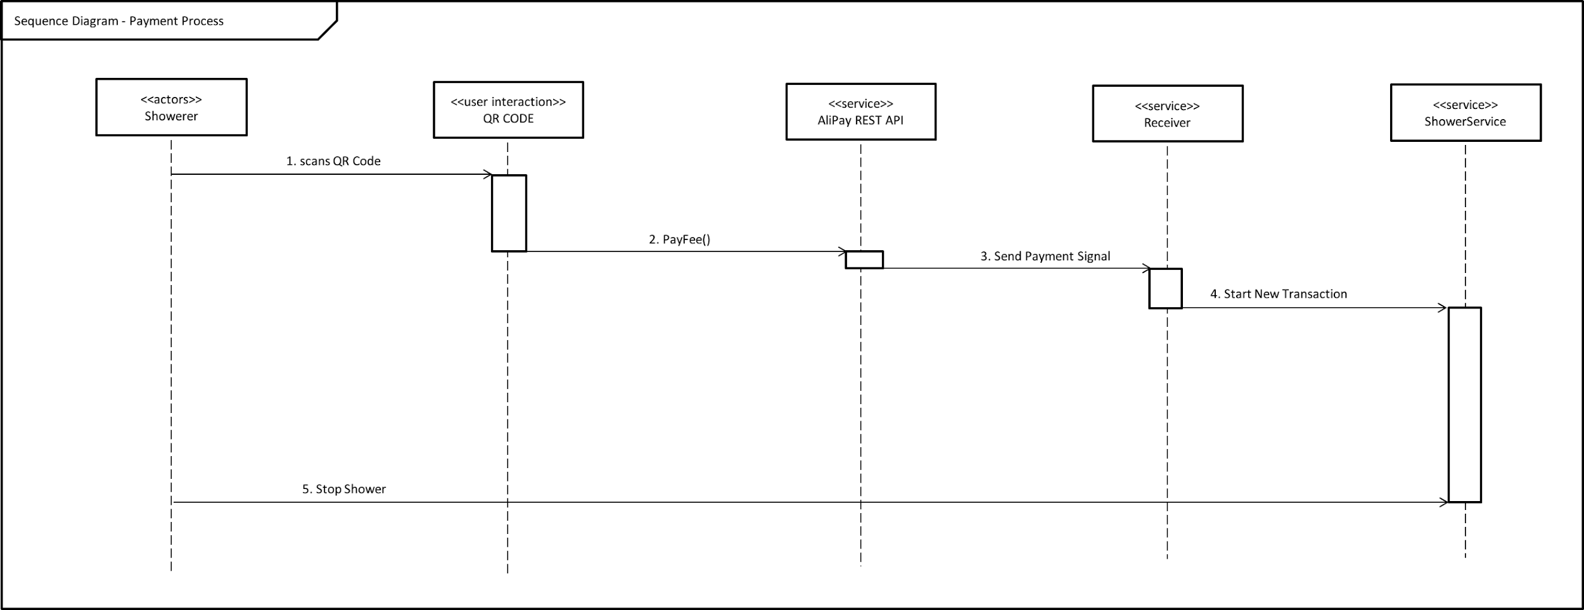
Dynamic Modelling
Sequence Diagram

Slide 22
Dynamic Modelling
Sequence Diagram Textual Description
The sequence diagram above the sequence of events involved in the payment process. Using the AliPay API the Pay to Go Shower System is able to process payment without any physical components. Once the payment has successfully been verified the shower will await the user’s initiation.

Slide 23
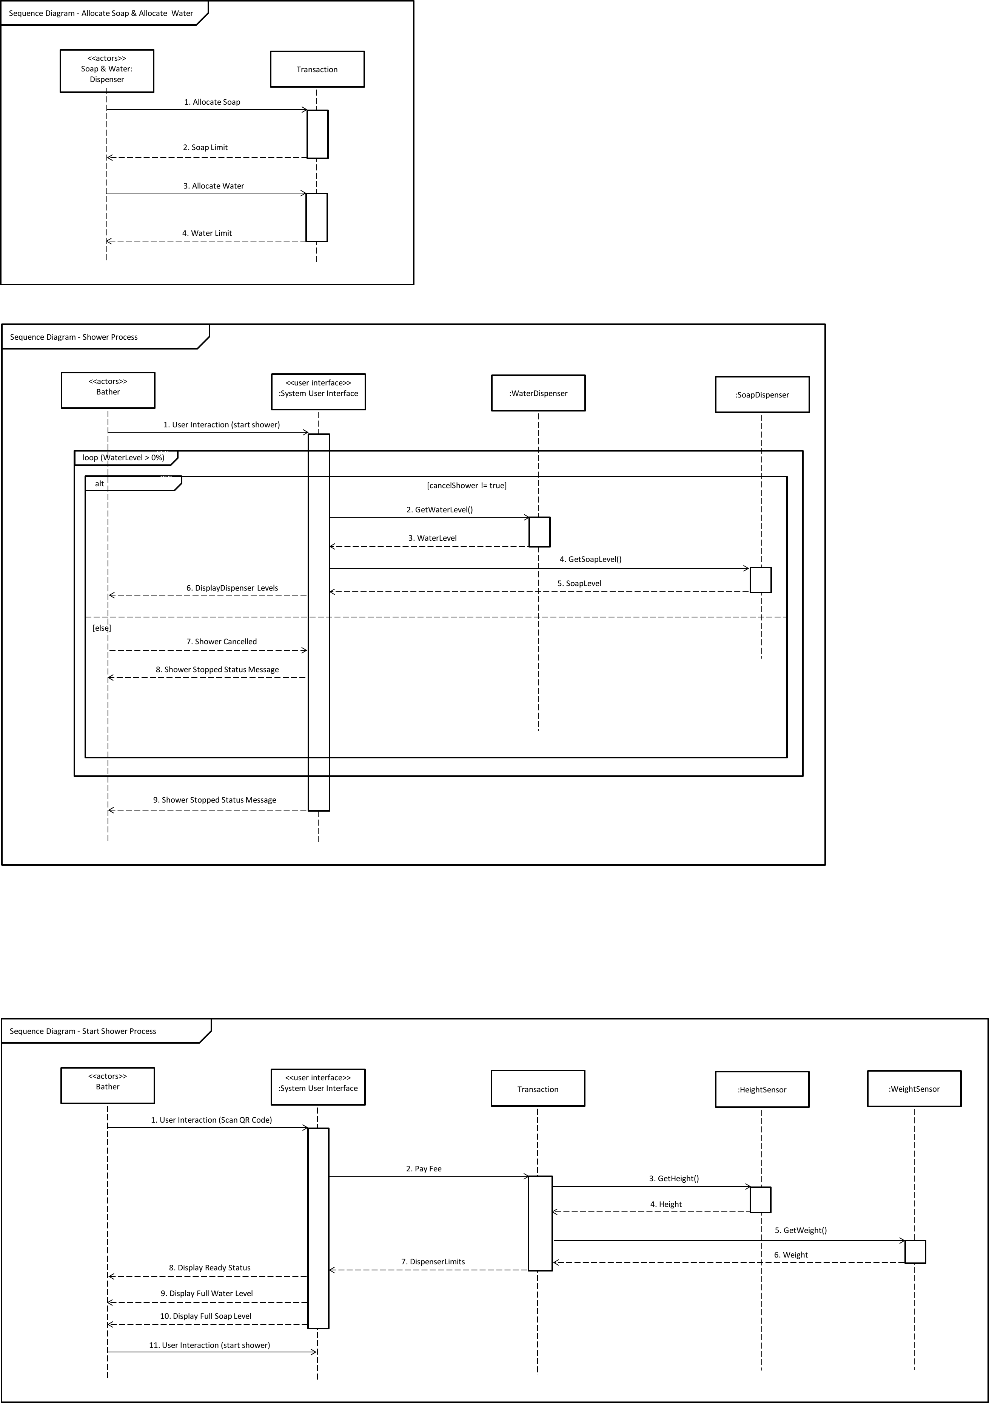
Dynamic Modelling
Sequence Diagram

Slide 24
Dynamic Modelling
Sequence Diagram Textual Description
The Sequence Diagram on the previous slide shows the start shower process. Once the user has scanned the QR Code and payed the flat fee, the API associated with the QR Code will return a true boolean value to the control unit of the shower system which will trigger the Shower Ready event where the dispensers are filled based on the user’s dimensions. The user can then start the shower process when ready.

Slide 25
Dynamic Modelling
Sequence Diagram

Slide 26
Dynamic Modelling
Sequence Diagram Textual Description
The Sequence Diagram above shows the processes involved in the actual shower. The shower process will continue as long as the water dispenser contains water and if the user has not stopped the process. However the user may turn on and off the water during the process.

Slide 27
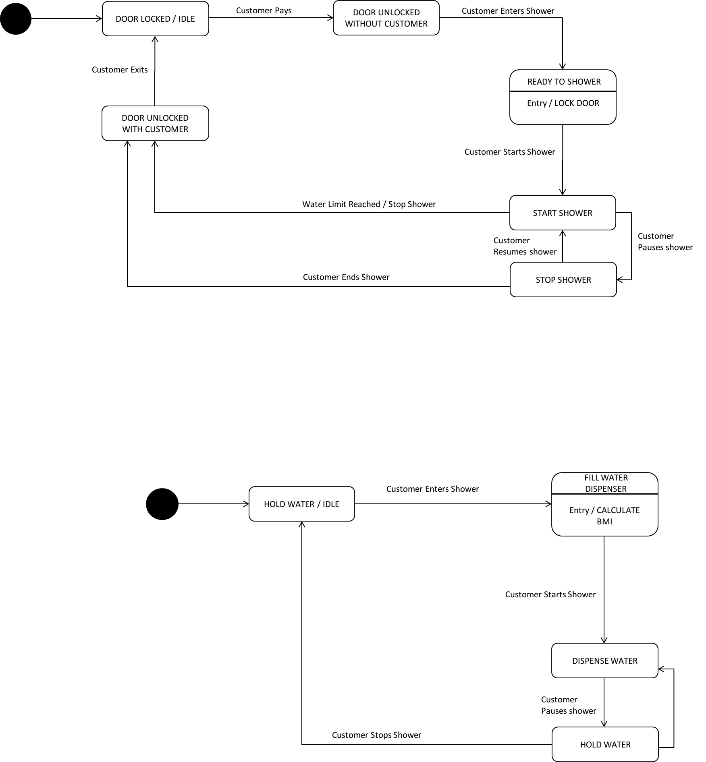
Dynamic Modelling
State Chart Diagram

Slide 28
Dynamic Modelling
State Chart Diagram Textual Description
The State Chart Diagram in the previous slide indicates the states of the entire Pay to Go Shower system. As shown during any stage of the shower the user is allowed to cancel the shower.

Slide 29
Dynamic Modelling
State Chart Diagram

Slide 30
Dynamic Modelling
State Chart Diagram Textual Description
The State Chart Diagram in the previous slide indicates the states of the water dispenser for the Pay to Go Shower system.

Slide 31
System Architecture

Slide 32
What is System Architecture ?
Software Architecture partitions a system structure into various subsystems and their related interfaces, where each subsystem is independent of other subsystems.

Slide 33
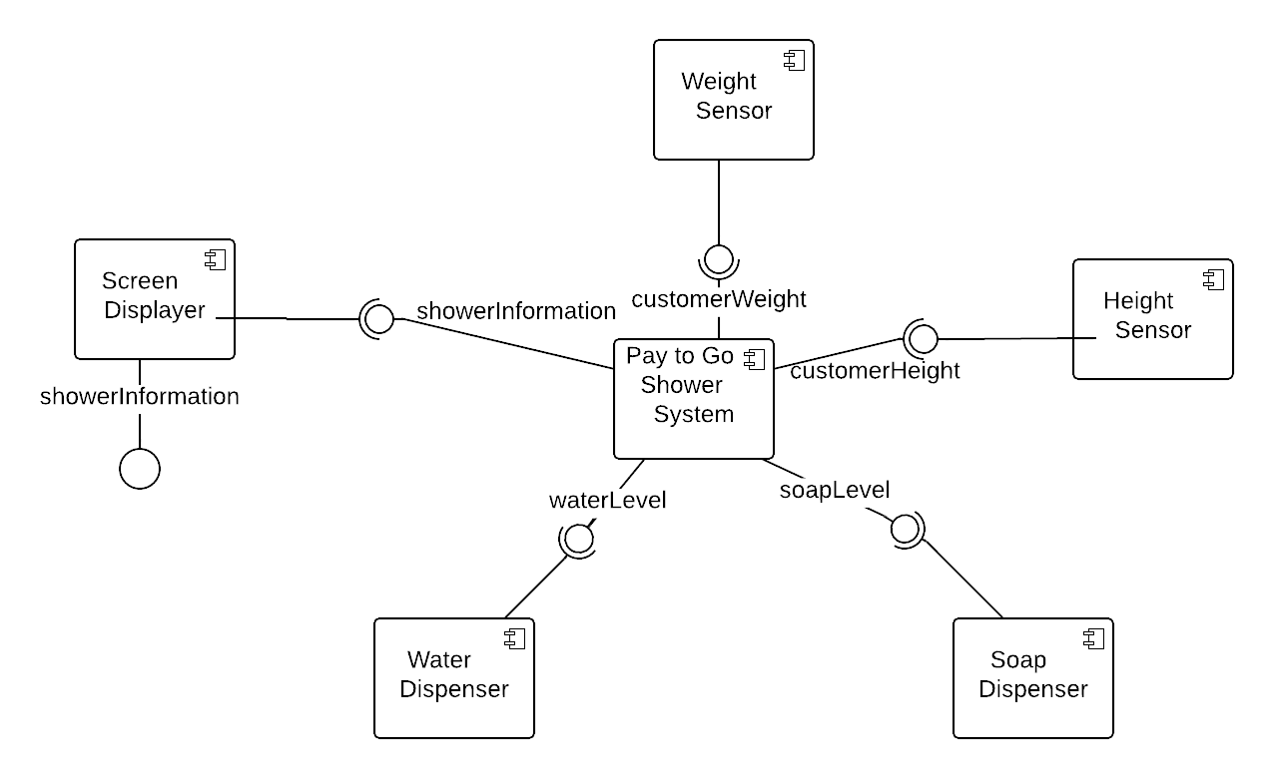
Software Architecture
Component Diagram

Slide 34
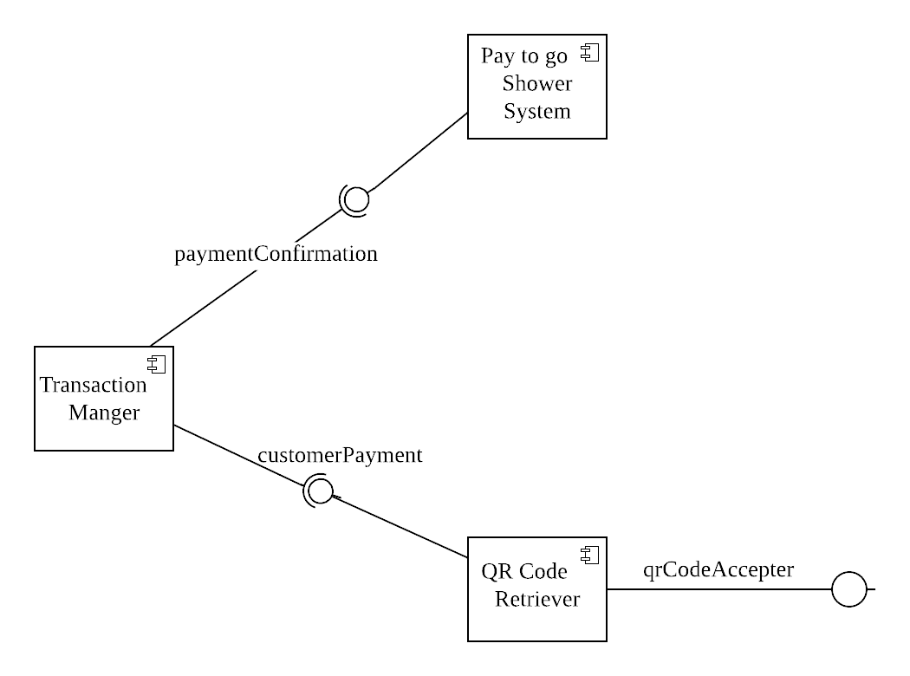
Software Architecture
Component Diagram

Slide 35
Software Architecture
Component Diagram Textual Description
The component diagrams on the previous slides show all the components that is included in the shower system along with the required and provided interface for each component. The first component diagram shows the components involved in the showering process of the system whilst the second diagram shows the components involved in payment process of the system.

Slide 36
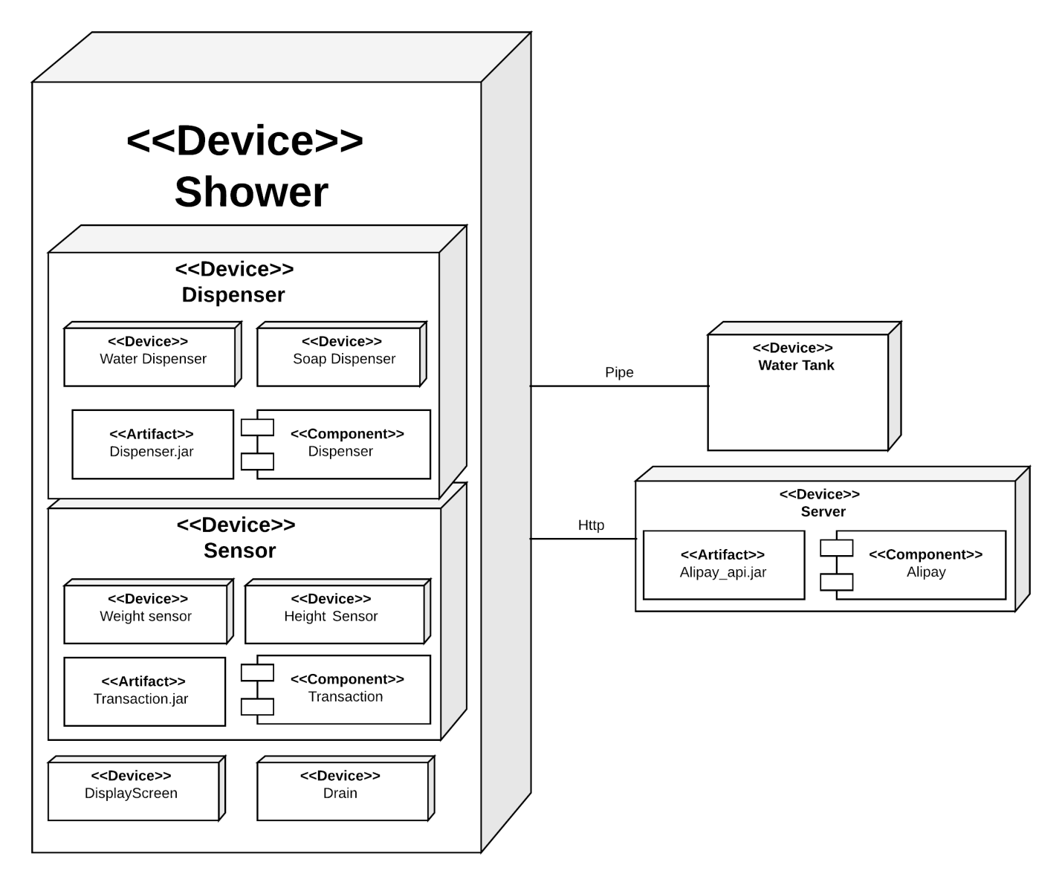
Software Architecture
Deployment Diagram

Slide 37
Conclusion

Slide 38
Conclusion
Sometimes individuals do not have immediate access to showers in public. The Pay To Go Shower System enables users to freshen up regardless of their location. Users simply scan the QR Code and pay for the service. The AliPay API will then send a confirmation signal to the shower system which will cause it to start a new transaction. This is what makes the system unique as another system is currently not well known.

Slide 39
Conclusion
Contributions
Ottor | Sequence Diagrams (revision), Use Case Diagrams (revision), Use Case Narratives, Class Diagram (revision), State Chart Diagram (revision),
Nicoy | Use Case Diagrams, Class Diagram, State Chart Diagram, Component Diagram (revision), Sequence Diagrams (draft)
Kenneth | Deployment Diagram, Use Case Diagrams, Class Diagram, State Chart Diagram, Component Diagram (revision)
David | Component Diagram, Use Case Diagrams, Class Diagram, State Chart Diagram, Component Diagram (revision)

Slide 40
System Deployment
The Pay to Go shower systems would be positioned in public places where individuals are more likely to want to take showers. Examples include the beach, or near a gym or courts (Individuals who take public transportation would want to freshen up before departing).

Slide 41
Thank You.

Slide 42
Content
Introduction
Requirement Analysis
Class Design
Dynamic Model Design
Layout of the System
Design of the Tables(If you use DB)
Conclusion
Q&A

